Slide 1
HOME AUTOMATION SYSTEM
Group 1:
Abhishek Subramanian (2018105002)
Dineshkumar V (2018105522)
Suriya R (2018105064)
Yogaram shos (2018105622)

Slide 2
Objective
The main objective of this project is to develop a home automation system that detects motion and turns the devices in a room on/off based on the presence of people in the room.
The need for such a project is that conventional switches are located in different parts of the house which make it cumbersome for people.
In order to overcome these limitations, we use motion detected sensors that sense when a person enters/ leaves a room and turns the various devices on/ off respectively.
This massively reduces human effort and interaction while also saving valuable energy.

Slide 3
Introduction
The project is implemented with the help of two motion detection sensors, one outside and one inside the room.
When a person enters a room, the sensor outside the room first gets activated followed by the sensor lying inside the room.
The user can manually override the automation system when needed.
When a person leaves the room, the sensor inside the room first gets activated and then the sensor outside the room gets activated.
A counter is used to keep a track of the number of people currently in the room. Only when the room is empty, the devices are turned off.

Slide 4
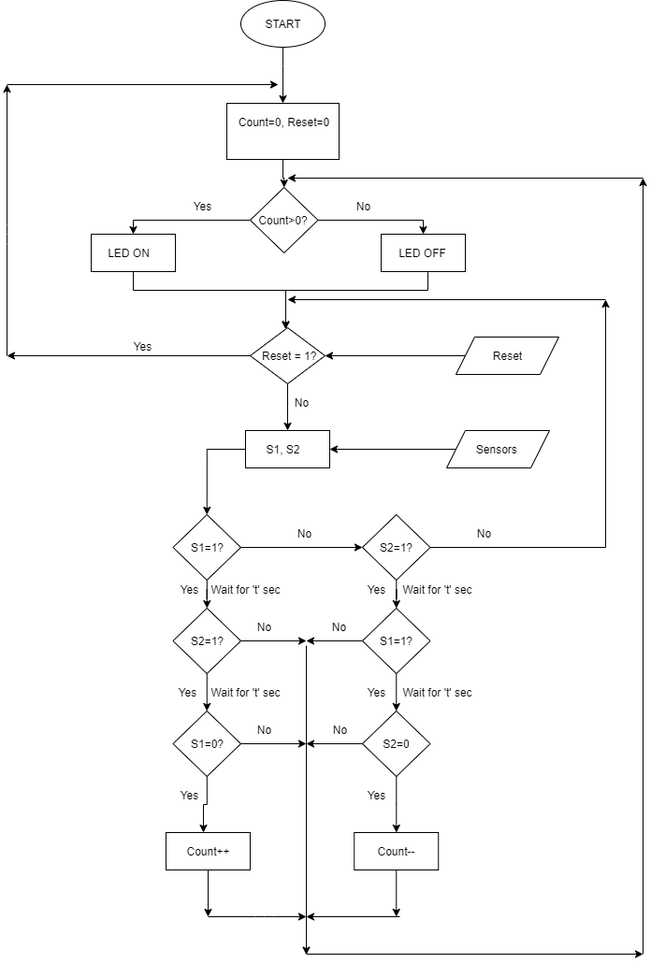
Method – Flowchart

Slide 5
Method – Manual Override
Logic Switch | Objective | Previous Manual Switch State | Operation
ON | OFF | ON | OFF
ON | OFF | OFF | ON, OFF
OFF | ON | ON | OFF, ON
OFF | ON | OFF | ON

Slide 6
Result
The sensors required to build this project have been acquired.
We have also come up with a comprehensive flowchart as well as the logic required to build the project upon.
The Verilog code required for the interaction of the HC-SR04 ultrasonic sensor and the Artix -7 Basys 3 FPGA Development Kit has been written and tested on.
The logic required for the functioning of the counters has also been developed.

Slide 7
Timeline
25th September, 2021 – Acquired the Artix – 7 Basys 3 FPGA Development Kit and will be testing the working of the HC-SR04 ultrasonic sensor.
29th September, 2021 – We would have written the Verilog code required for the working of the counter and would have also connected the LED to our board.
4th October, 2021 – We will be done testing for any bugs and small issues with the logic. We would have also done a number of trial runs in order to ensure smooth functioning.

